Slide 1
Documentation Lead
Jessica Sok

Slide 2
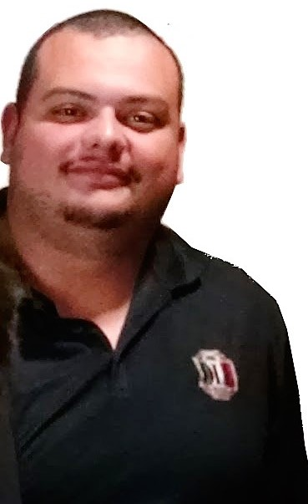
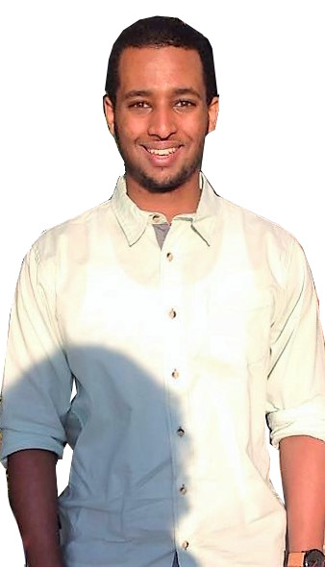
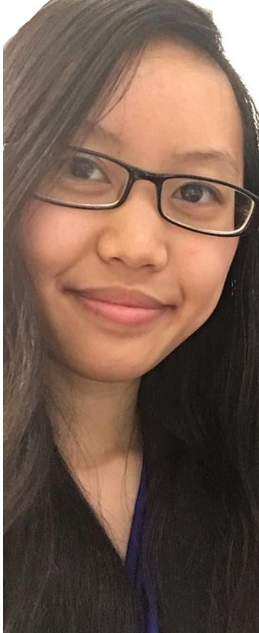
T E A M
T
R
I
P
L
E
J
Notes:
Team selfie/group photo

Slide 3
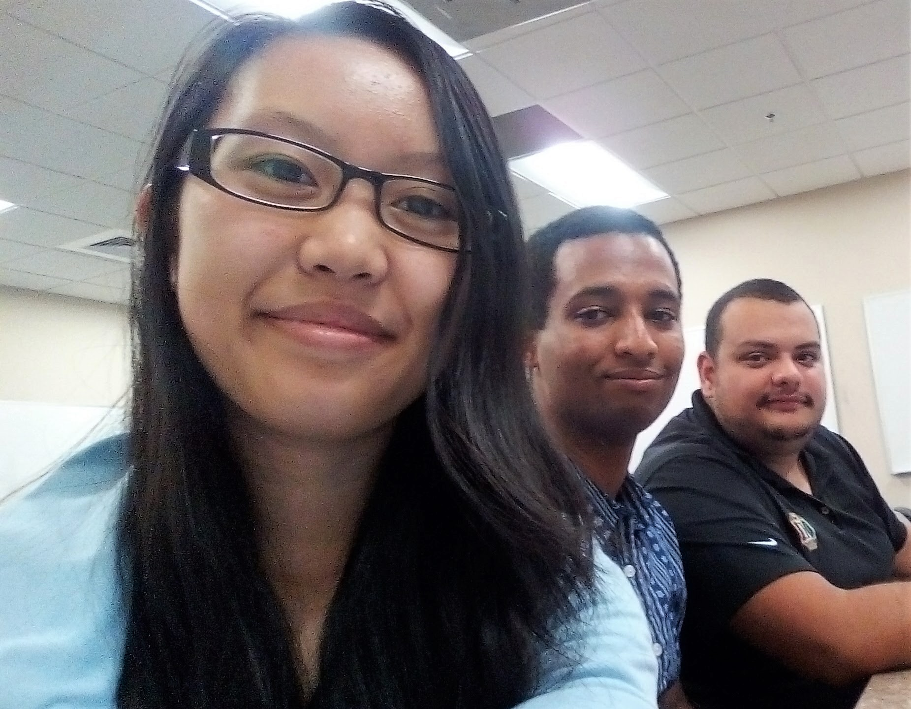
T E A M
T
R
I
P
L
E
J

Slide 4
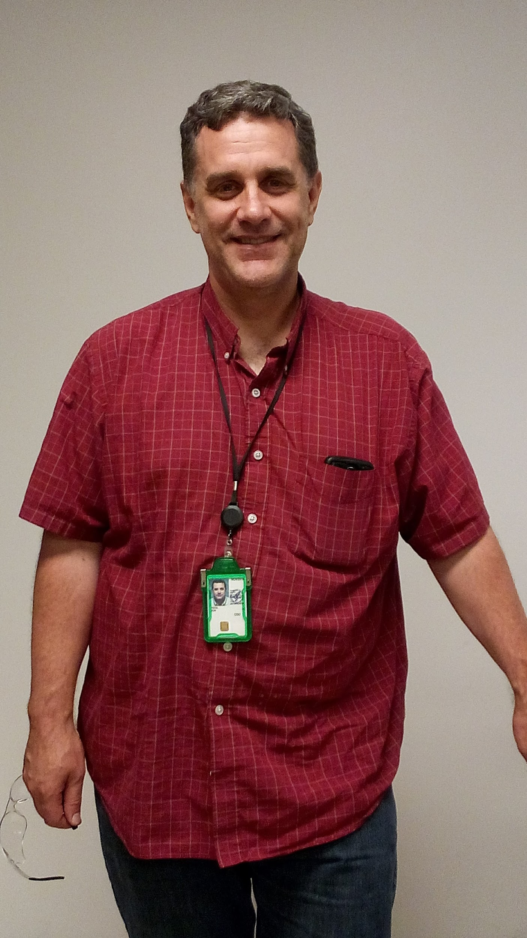
Our Client: Dr. Jon Rees
Part-time Chemistry Faculty
Ph.D in Applied Chemistry
Research Chemist at the Center for Disease Control and Prevention (CDC)
Current research involves dealing with cholesterol/lipids.
Request: Develop an android application to compute the mass value of lipid ions.
Notes:
Client photo and bio

Slide 5
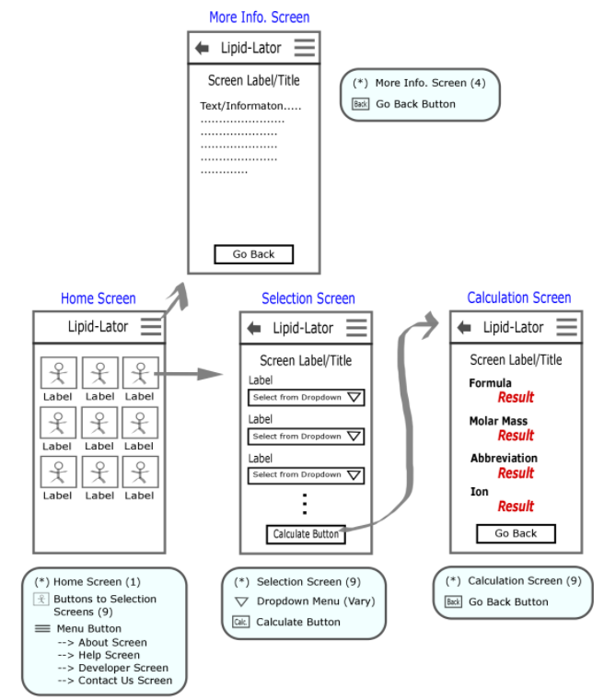
User Documentation
Direct Application Download
Transfer through USB cable
Or download APK file from email
User Documentation Screens:
About App
Help
Contact Us
Contain information about our team members
Notes:
Plan for user documentation: help screens, download page, etc

Slide 6
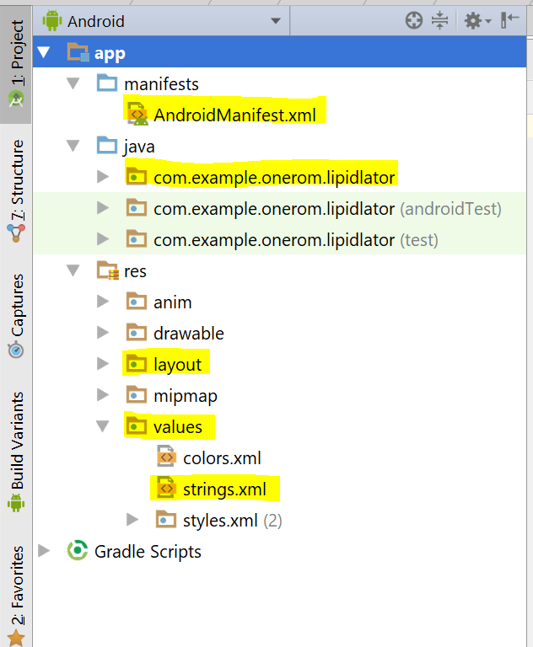
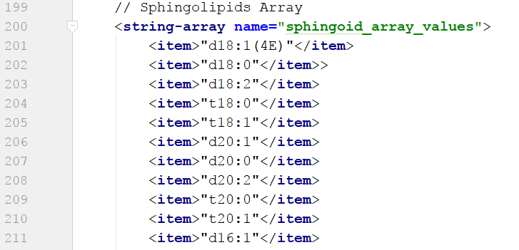
Code Documentation
Organization
→ Folders
→ Subfolders
→ Files & Classes
Comments
Notes:
Format of code documentation and technology for creating autodocs (if applicable)

Slide 7
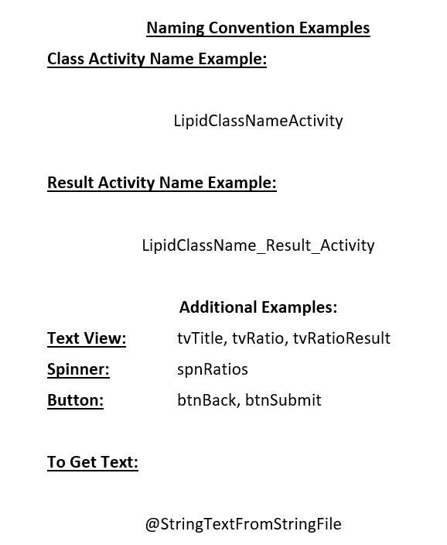
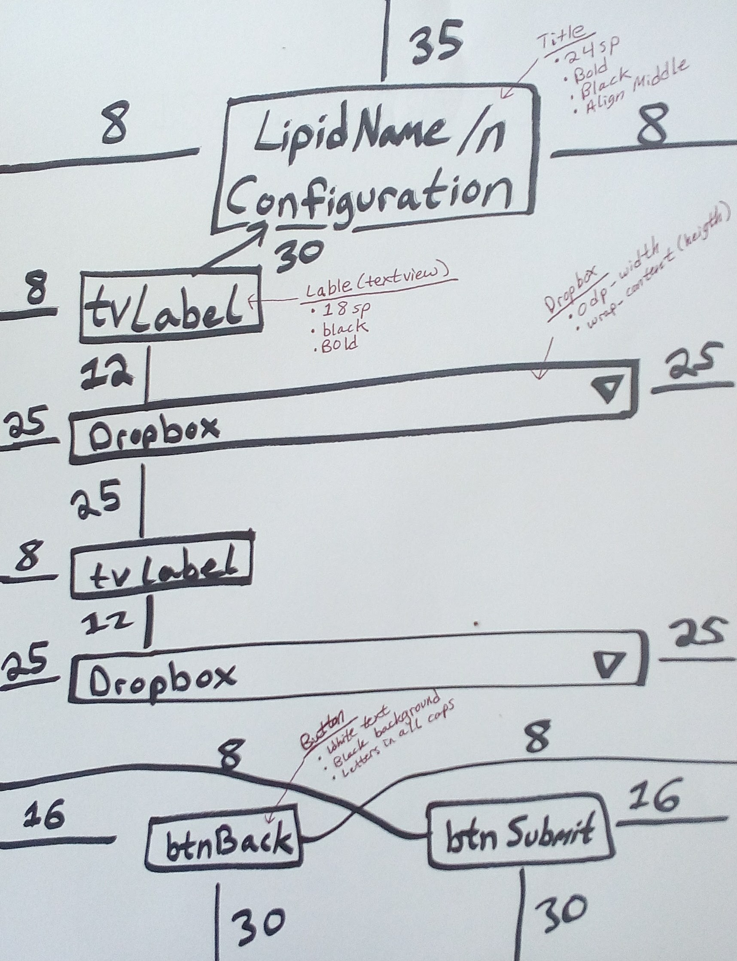
Code Documentation:
Naming & Layout Convention

Slide 8
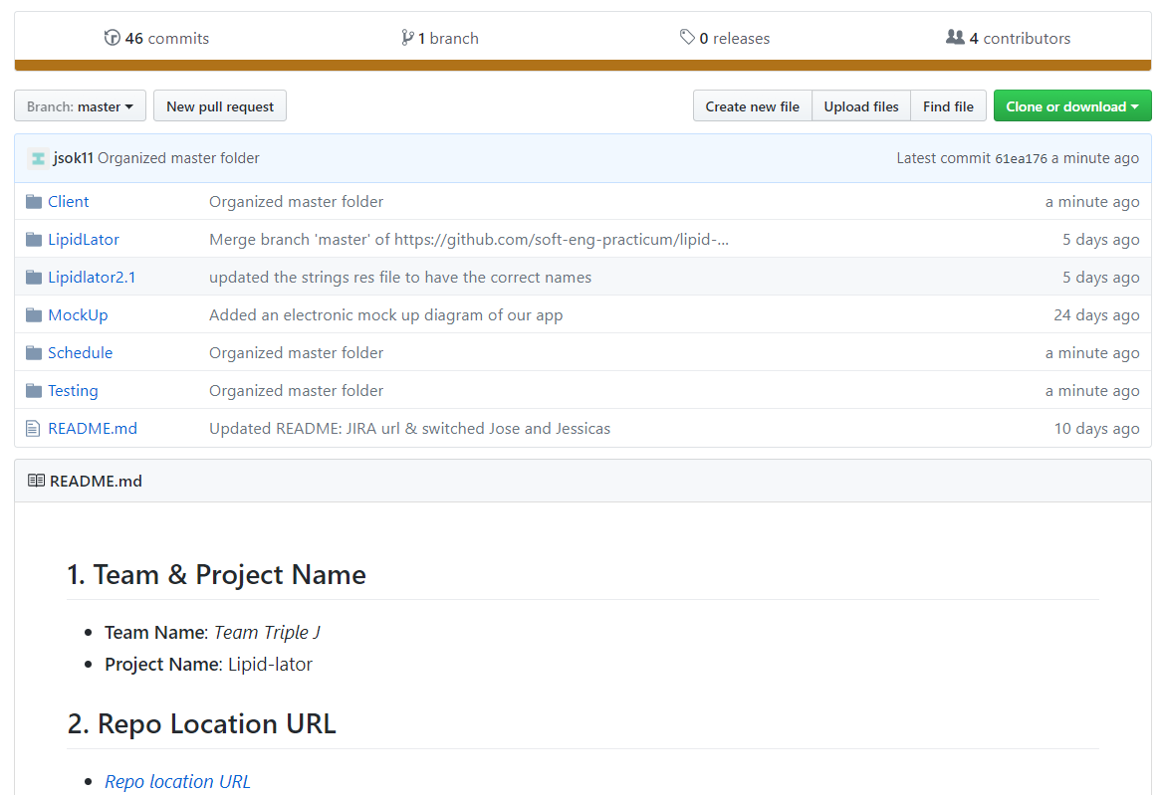
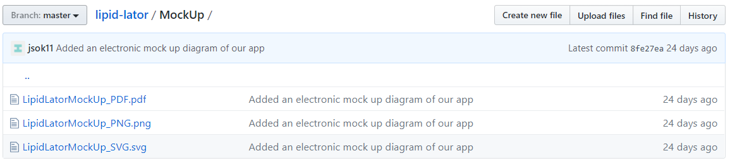
Github Repo Documentation
Notes:
Github repo documentation organization

